Slide 1
Outline
1- Introduction
2- Objective
3- Main problem of the project
4- Suggestion to solve the problem
5- Results
6- Aim of the project
7- Future Work

Slide 2
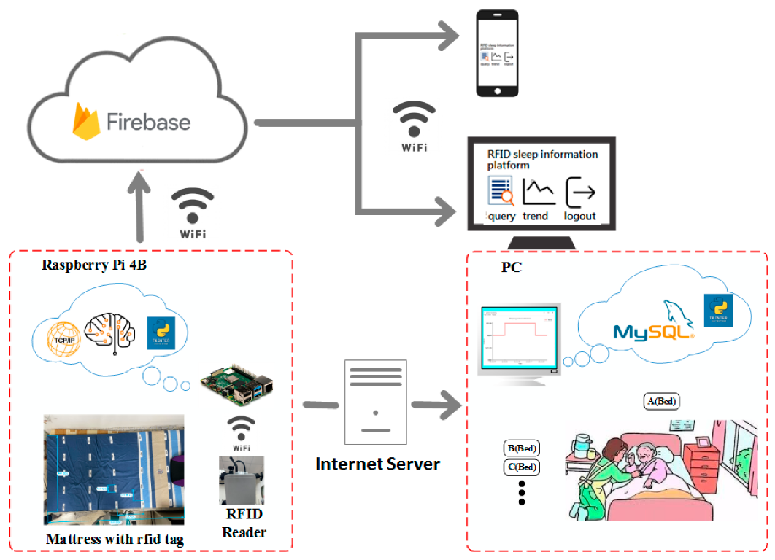
Introduction
The integration of IoT and RFID has transformed patient monitoring by enabling real-time, continuous observation of vital signs. Traditional hospital systems lacked automation, often requiring constant nurse intervention. This project addresses that gap by proposing a smart, real-time system capable of detecting health anomalies and sending immediate alerts. The device continuously monitors temperature, heart rate, blood oxygen, and environmental conditions, improving response times in emergencies.
It also allows remote access to patient data through cloud storage, enhancing decision-making.

Slide 3
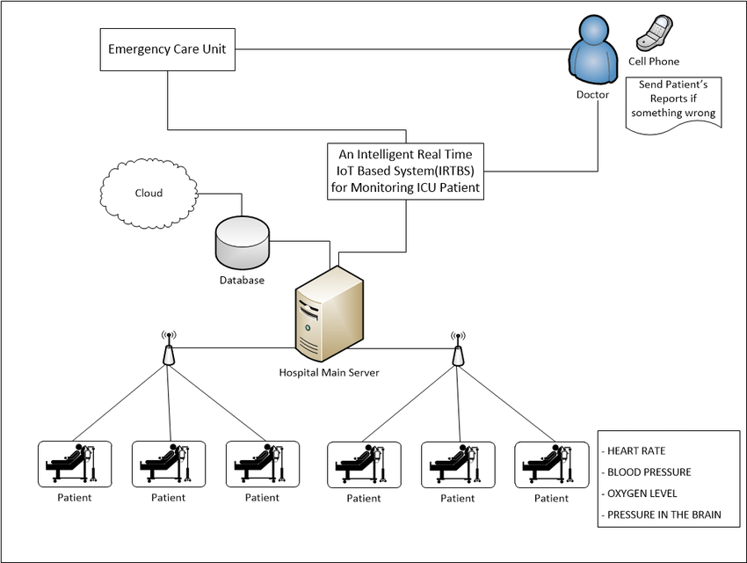
Objective
The primary objective of this project is to design a scalable, cost-effective, and real-time patient monitoring system that reduces manual workload and improves hospital efficiency. By employing wearable sensors and RFID technology, the system continuously tracks patients’ health metrics, alerts healthcare providers during emergencies, and ensures accurate patient identification.
This approach minimizes medical errors and improves safety. It also provides a real-time dashboard for clinicians and supports encrypted data sharing for remote access.

Slide 4
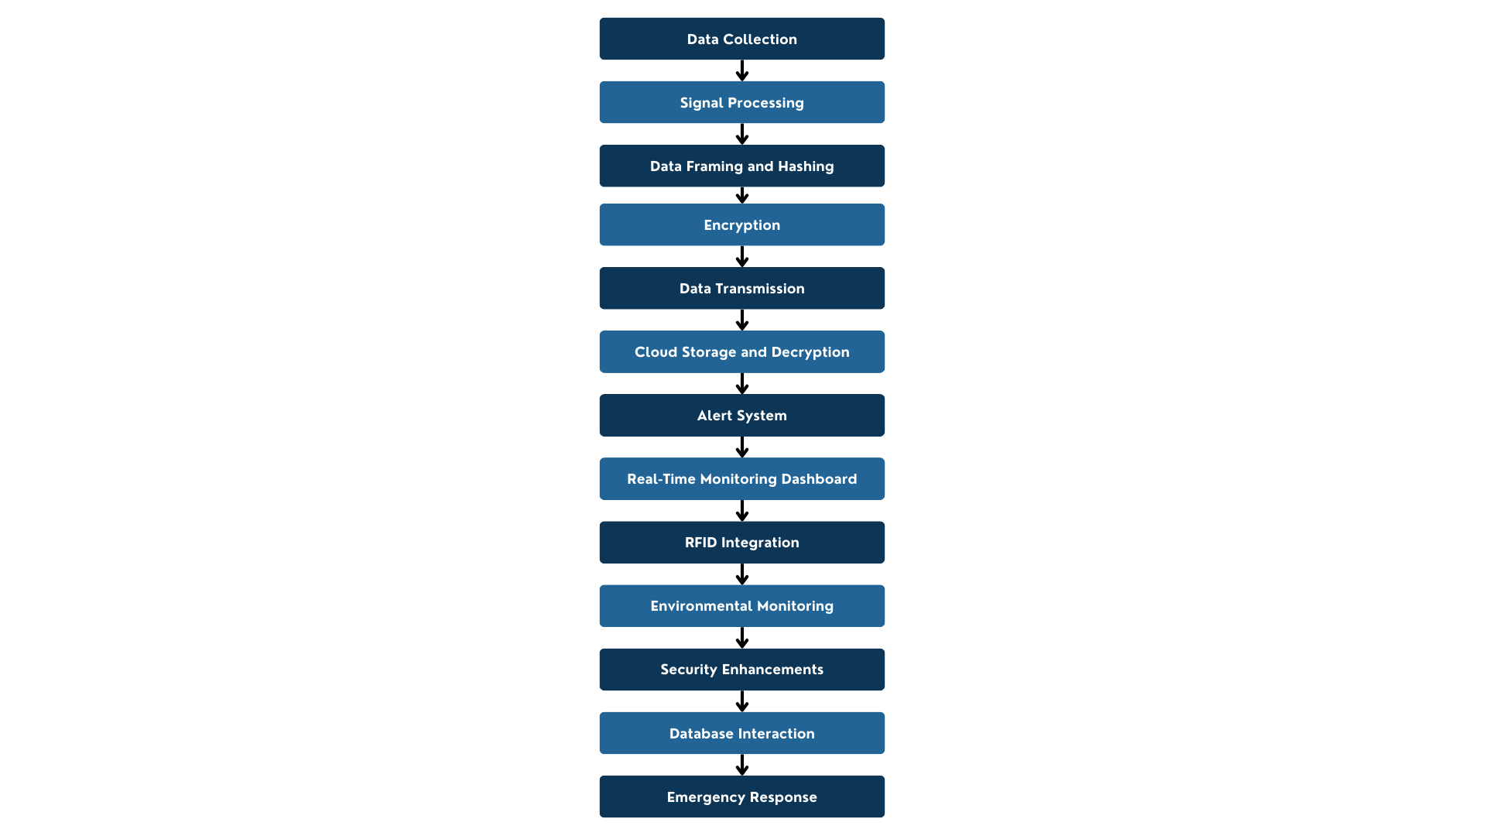
Main Problem of the Project
Current hospital systems struggle with delayed responses, manual monitoring, misidentification of patients, and lack of environmental adaptation. Nurses face high workloads, and emergencies may go unnoticed. Traditional RFID lacks integration with health data, and many IoT setups suffer from poor security or scalability.
The problem tackled here is how to integrate all monitoring needs—vital signs, location, alerts—into one intelligent, secure, real-time system that supports scalability and remote access.

Slide 5
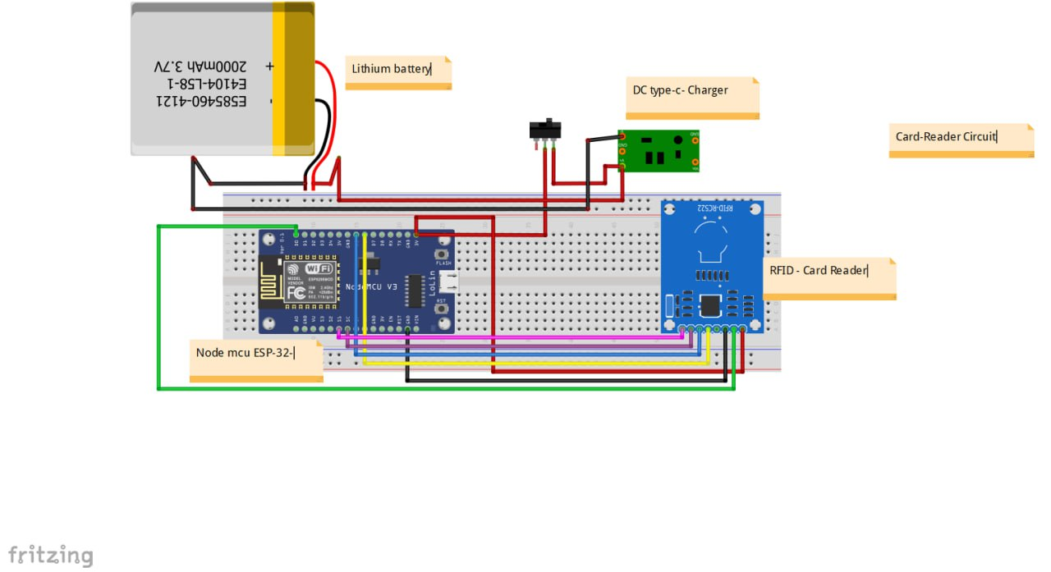
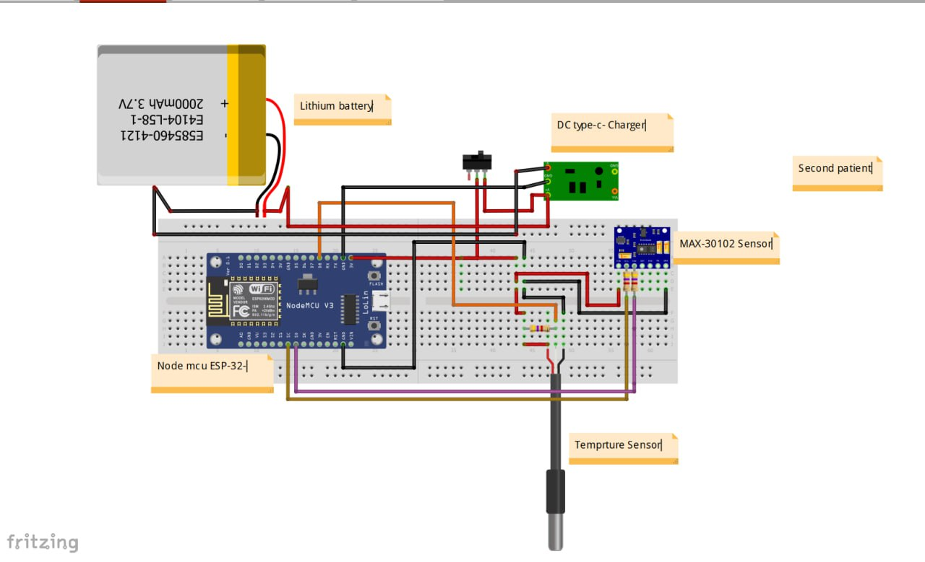
Suggestion to Solve the Problem
The solution integrates IoT sensors (heart rate, temperature, SpO₂) and RFID tags with secure cloud infrastructure. An Arduino-based microcontroller (ESP-32) collects, encrypts, and transmits data via Wi-Fi. RFID ensures patient identification and location tracking. Alerts are automatically triggered for abnormal vitals. Data is hashed with SHA-256 and encrypted with AES-128 to protect integrity. A centralized dashboard displays real-time data for healthcare providers, improving response times and reducing workload.
main server and circuit
circuit of first and second patient

Slide 6
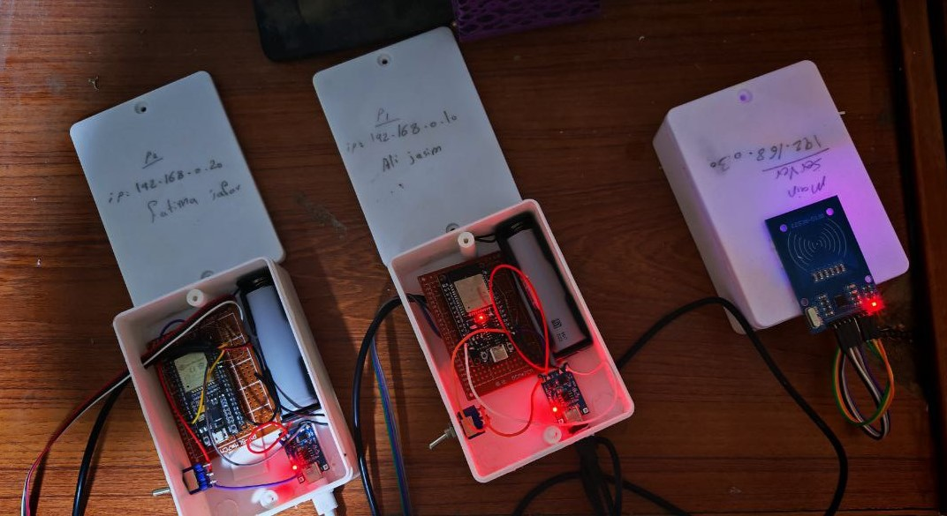
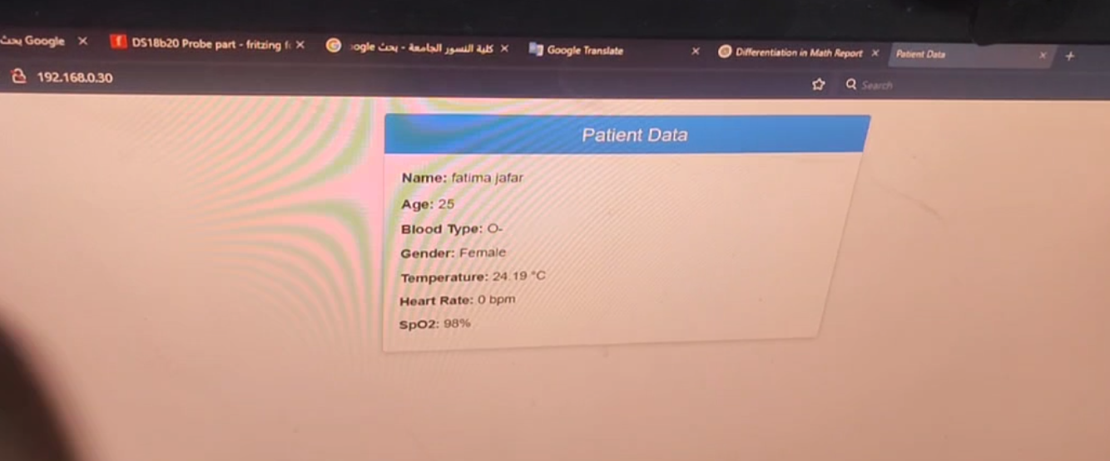
Results
The system was successfully implemented and tested with real patient data. It accurately collected heart rate, temperature, and oxygen levels, transmitted securely to cloud storage, and displayed on a real-time dashboard. RFID tags were effectively used for patient identification. Emergency alerts were sent automatically when thresholds were exceeded. The system reduced manual intervention, increased monitoring accuracy, and improved response times.
Project in Real Life
Main Server Data

Slide 7
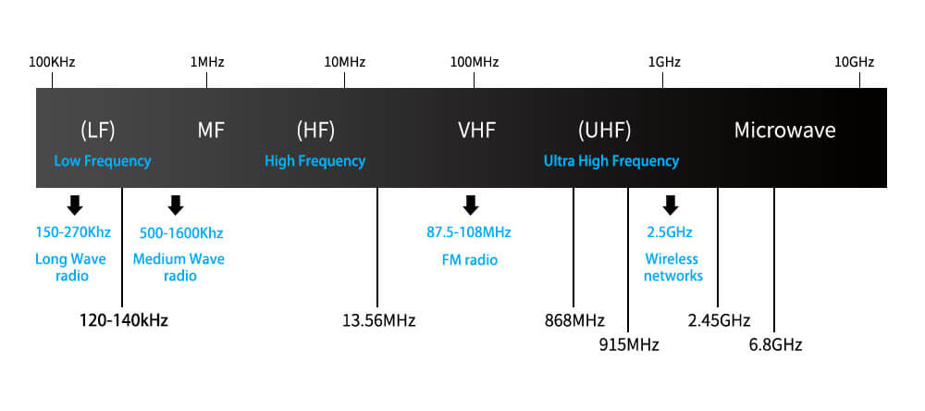
Aim of the project
This project aims to build a robust, intelligent system for continuous hospital patient monitoring using IoT and RFID. It strives to improve healthcare safety, reduce the nurse workload, and provide immediate alerts in emergencies. It also enables remote tracking and future AI integration. The system uses secure data handling, central dashboards, and automated controls for hospital room conditions, making it highly suitable for scalable deployment.
RFID Frequency Bands
IoT Health Monitoring System

Slide 8
Future work
Future development will include integrating artificial intelligence for predictive analytics, detecting disease risks early. A mobile app will allow caregivers real-time access and alerts. Additional sensors will monitor glucose levels and respiratory activity. Blockchain may be used to secure health data, and energy-efficient IoT devices will reduce operational costs. The system could also support telemedicine, scale across multiple hospitals, and be refined through real-world clinical feedback.
AI-Powered Health Prediction
Integrate machine learning algorithms to analyze historical health data for predicting critical events like cardiac arrest, enabling proactive care.
Mobile App for Caregivers
Develop a cross-platform mobile application for real-time patient monitoring, notifications, and location tracking for doctors and family.
Expanded Sensor Suite
Add sensors for glucose monitoring, respiratory rate, and ECG patterns to support a broader range of chronic disease monitoring.
Blockchain Security
Use blockchain to ensure tamper-proof, decentralized storage of sensitive patient data, enhancing data trust and traceability.
Scalable Multi-Hospital Deployment
Optimize the system architecture for large-scale deployment across hospitals, enabling seamless integration and feedback-based improvements.

